Slide 1
Indexing in Key-Value Stores
Suresh Siddharth
CSCI-5980

Slide 2
Why Indexing?

Slide 3
Why do we need indexes?
Key-Value stores are becoming the de facto standard for most Big Data applications. These databases need to serve huge volumes of data at minimal time.
Challenges
Limited RAM availability
Indexing is an overhead
Traditional NoSQL indexing does not support query by value
Optimized for read or write performance?

Slide 4
Kinds of Indexes
Generally, most indexes fall under one the following categories:
LSM-Tree/SSTable Based
B-Tree Based
Of course, there are more!

Slide 5
LSM-Tree/SSTable
This is the indexing scheme followed by the more popular key-value stores in the market. Google’s BigTable, Amazon’s DynamoDB, and LevelDB to name a few.
Design Considerations
Write optimized
Low write amplification
Compaction process can interfere with DB performance

Slide 6
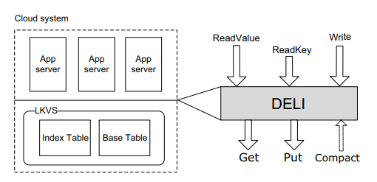
DEferred Lightweight Indexing for Log-Structured KV Stores (DELI)
Paper by Yuzhe Tang et. al. which talks about how indexing can be achieved for ‘values’.
Highlights
New table with inverted key/values
Utilize versioning for chaining value indexes
Both online and offline mode proposed
Defer get calls as much as possible
Processing get calls after compaction
Paper and Image citation: Y. Tang, A. Iyengar, W. Tan, L. Fong, L. Liu and B. Palanisamy, "Deferred Lightweight Indexing for Log-Structured Key-Value Stores," 2015 15th IEEE/ACM International Symposium on Cluster, Cloud and Grid Computing, Shenzhen, 2015, pp. 11-20.

Slide 7
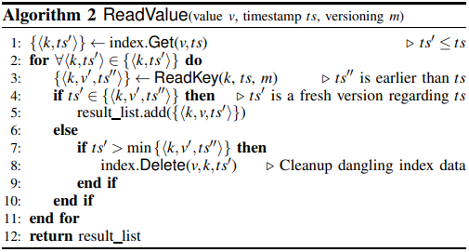
DEferred Lightweight Indexing for Log-Structured KV Stores (DELI)
A index entry is created by the following steps:
Reading the old version from the base table
Deleting old version of key k in index table
Inserting new version to the base table
Inserting new version to the index
Here, steps 1 and 2 are deferred for the read process, as it
would have to do a GET call anyway.
Paper and Image citation: Y. Tang, A. Iyengar, W. Tan, L. Fong, L. Liu and B. Palanisamy, "Deferred Lightweight Indexing for Log-Structured Key-Value Stores," 2015 15th IEEE/ACM International Symposium on Cluster, Cloud and Grid Computing, Shenzhen, 2015, pp. 11-20.

Slide 8
bLSM: A General Purpose Log Structured Merge Tree
Designed by Yahoo! to serve as the backend for PNUTS (geographically distributed key-value storage) and Walnut (elastic cloud storage)
Highlights
Targets the read-amplification of using LSM-Trees
Uses 3 LSM-Trees, with the larger 2 protected by Bloom Filters
Allows for zero-seek “insert if not exists”
We ensure reads can stop after finding one version of a record
Paper citation: Russell Sears and Raghu Ramakrishnan. 2012. BLSM: a general purpose log structured merge tree. In Proceedings of the 2012 ACM SIGMOD International Conference on Management of Data (SIGMOD ’12). Association for Computing Machinery, New York, NY, USA, 217–228.
Notes:
Discussion points:
Decreasing read to write ratio found by Yahoo!. 90% read in 2010 to 50% in 2012.
Here, each LSM tree is a B-Tree

Slide 9
Megastore
Megastore is a storage system developed by Google which blends the scalability of a NoSQL datastore with the convenience of a traditional RDBMS.
Highlights
Uses BigTable under the hood.
Uses inline-indexing to allow for indexing with denormalized data.
Secondary Indexes are stored as separate rows within the same table.
Example: user id, time = primary key
Paper citation: Russell Sears and Raghu Ramakrishnan. 2012. BLSM: a general purpose log structured merge tree. In Proceedings of the 2012 ACM SIGMOD International Conference on Management of Data (SIGMOD ’12). Association for Computing Machinery, New York, NY, USA, 217–228.

Slide 10
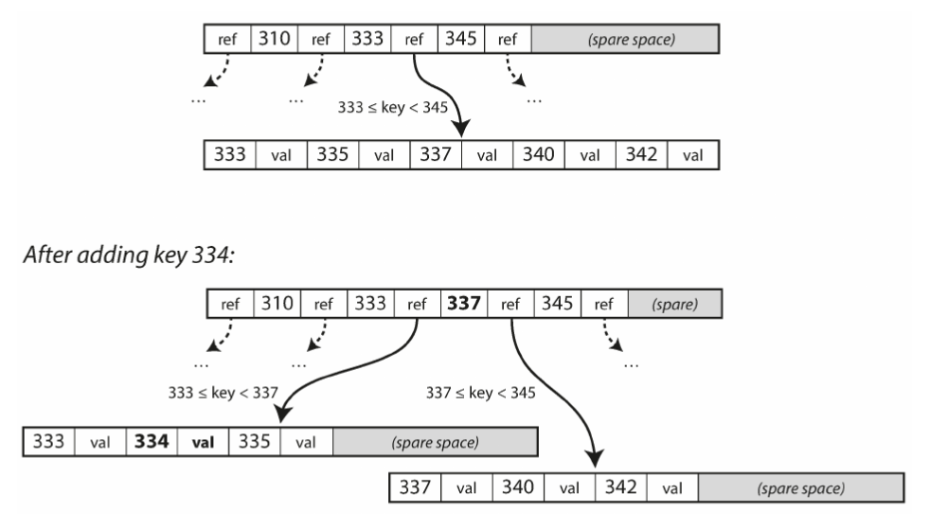
B-Trees
B-trees is one of the most common data structure used in Indexing. It is widely prevalent in most relational databases, but are also increasingly being used in NoSQL databases like CouchDB.
Design Considerations
Write intensive
Almost ideal read performance
Deletes can be tricky as the tree needs to be balanced

Slide 11
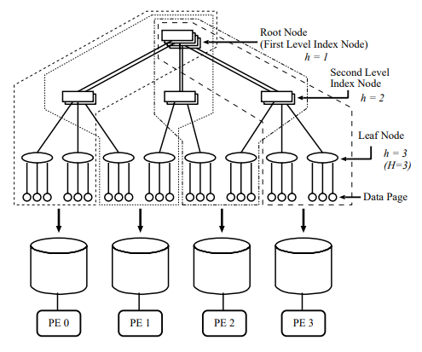
Fat-Btree: An Update-Conscious Parallel Directory Structure
Paper by H. Yokota et. al. on how B-Trees can be processed
parallely.
Highlights
Designed to work with shared-nothing architectures
Sub-trees of the B-Tree assigned to Processing Elements
Lightweight data-page migration
Might need more read request handoffs
Parallel processing of range queries
Paper and Image citation: H. Yokota, Y. Kanemasa and J. Miyazaki, "Fat-Btree: an update-conscious parallel directory structure," Proceedings 15th International Conference on Data Engineering (Cat. No.99CB36337), Sydney, NSW, Australia, 1999, pp. 448-457.
Notes:
Previous iterations did not consider parallel

Slide 12
Indexing on Intervals

Slide 13
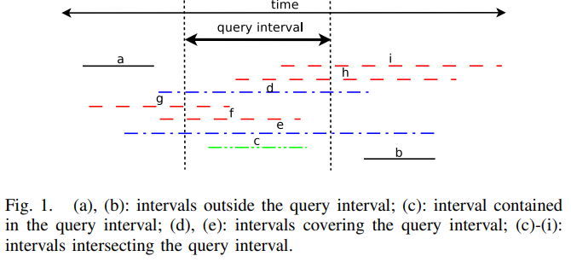
Interval indexing and querying on key-value cloud stores
Paper by G. Sfakianakis et. al. which proposes a novel solution for creating interval indexes in Key-Value stores
Challenges
Intervals are different from range queries
There are usually implicit assumptions made
when processing such queries
Data for queries are not usually present in
key of the key-value stores
Nature of data that involve such queries -
spatial, temporal, and scientific
Paper and Image citation: G. Sfakianakis, I. Patlakas, N. Ntarmos and P. Triantafillou, "Interval indexing and querying on key-value cloud stores," 2013 IEEE 29th International Conference on Data Engineering (ICDE), Brisbane, QLD, 2013, pp. 805-816.

Slide 14
Interval indexing and querying on key-value cloud stores
The paper proposes two index structures - MRSegmentTree and EndPoint Index.
Highlights
Algorithms proposed are suited for cloud based key-value stores
Use the MapReduce for efficient and scalable implementation
Can be extended to be used in any NoSQL database implementation
High Level Process
Compute the EndPoint Index structure using a MapReduce job
Use the EndPoint Index to create a SegmentTree in a separate MapReduce Job
Paper citation: G. Sfakianakis, I. Patlakas, N. Ntarmos and P. Triantafillou, "Interval indexing and querying on key-value cloud stores," 2013 IEEE 29th International Conference on Data Engineering (ICDE), Brisbane, QLD, 2013, pp. 805-816.

Slide 15
Interval indexing and querying on key-value cloud stores
The process for creating the End Point Index is as follows:
Run a MapReduce job where each mapper is assigned a subset of the entire data
For each row, the mapper emmits two rows: {begin: < ”r”|rowkey = end >} and {end: < ”l”|rowkey = begin >}
This creates an inverted index which is stored in the underlying database
Certain considerations need to be accounted for in this job. There will be cases when the end-point is not explicitly defined, and the mapper will have to compute the same.
The entire write operation can also be optimized be using HFiles as an intermediary for bulk inserts.
Paper citation: G. Sfakianakis, I. Patlakas, N. Ntarmos and P. Triantafillou, "Interval indexing and querying on key-value cloud stores," 2013 IEEE 29th International Conference on Data Engineering (ICDE), Brisbane, QLD, 2013, pp. 805-816.

Slide 16
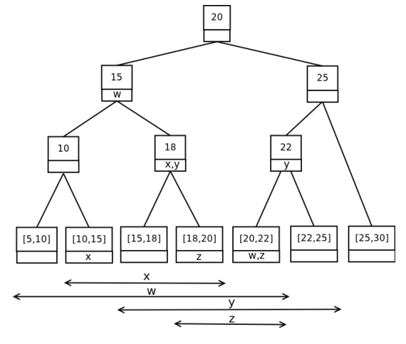
Interval indexing and querying on key-value cloud stores
The process for creating the MRSegmentTree Index is as follows:
First, a MR job is run on a subset of the EPI
Each mapper creates a sub-tree of the elements it has been
assigned
The “top-tree” is precomputed in the start-up phase of MR,
and each mapper updates this tree with its corresponding
subtree.
A unique row-key is created for the root node
Paper citation: G. Sfakianakis, I. Patlakas, N. Ntarmos and P. Triantafillou, "Interval indexing and querying on key-value cloud stores," 2013 IEEE 29th International Conference on Data Engineering (ICDE), Brisbane, QLD, 2013, pp. 805-816.

Slide 17
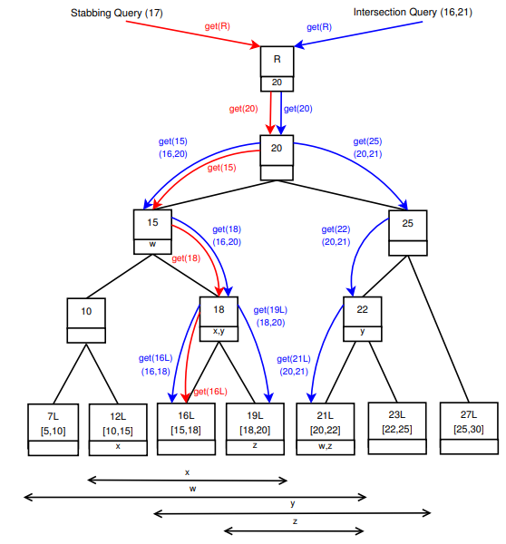
Interval indexing and querying on key-value cloud stores
The figure to the left shows how the execution of intersection and stabbing queries take place.
Index Updates
Index updates are handled via a separate Updates Index.
This is a smaller version of the EPI, which tracks updates similar to a write-ahead log and is merged to the main index periodically
Paper citation: G. Sfakianakis, I. Patlakas, N. Ntarmos and P. Triantafillou, "Interval indexing and querying on key-value cloud stores," 2013 IEEE 29th International Conference on Data Engineering (ICDE), Brisbane, QLD, 2013, pp. 805-816.

Slide 18
Indexing in Key-Value Stores
Suresh Siddharth
CSCI-5980

